Slide 1
Building An Analytics-Enabled Security Operations Ctr (SOC)
Mike Munn
Splunk Engineering Manager

Slide 2
Who Can Benefit From This PPT?
Wants to
Build a SOC
Primary:
Wants to Enhance
Existing SOC
Performs SOC-Like
Functions
Secondary:
Notes:
“Want to build a SOC” customers are primary audience and others are secondary. But even small orgs with no formal SOC plans can learn from this PPT.
The material in this PPT is what our customers across many industries and sizes tend to do. It’s just a summary…precise SOC requirements will be different for each organization.

Slide 3
What is a Security Operations Center (SOC)?
Centralized location(s) where key IT systems of an organization are monitored, assessed and defended from cyber attacks.
Security
Operations
Center
PRIMARY GOAL: Reduce risk via improved security
SECONDARY GOALS: Compliance, anti-DDOS attack, fraud detection
Notes:
Without a SOC there often is siloed, incomplete visibility which leads to a weaker security posture. So by consolidating all the security experts and relevant data into a central location, threats can be spotted faster and efficiencies can be had.

Slide 4
Before Building SOC Need to Understand:
Significant upfront and ongoing investment of money and time
Prerequisite is a certain security maturity level
Structure will vary for each organization
Important to prioritize and phase the build-out
Executive-level and business unit support required
Notes:
To build a SOC you need basic security products/process in place and tuned (see SANS 20 for examples), as well as enough skilled people to run a SOC. If you do not have a basic level of maturity, you may need to address this first before building a SOC.
Prioritization includes: data sources to onboard (onboard the most critical sources first), which threats to model out and look for, playbooks, people, staffing hours (start 8x5 and move to 24/7, etc)

Slide 5
Three Interrelated Components of a SOC
Process
Technology
People
Notes:
Any SOC is comprised of people, process, and technology. All 3 are critical to a successful SOC

Slide 6
Process

Slide 7
Threat Modeling & Playbooks
What threats does the organization care about?
Intellectual property or customer data loss, compliance, etc.
Prioritize based on impact
1
2
What would the threat look like?
How it would access and exfiltrate confidential data
Requires machine data and external context
Searches or visualizations that would detect it (correlated events, anomaly detection, deviations from a baseline, risk scoring)
3
How would we detect/block the threat?
What is the playbook/process for each type of threat?
Severity, response process, roles and responsibilities, how to document, how to remediate, when to escalate or close, etc.
4
Notes:
This is step one of the SOC build out and prioritizes where to get started.
1. Could also include DDOS, protecting an asset or person, etc. Business people will help you decide this, perhaps based on overall $$ a specific threat could cost the organization.
2. The “indicators of compromise”
3. Includes: machine data to spot the threat (this drives which data sources to prioritize). Also searches needed to detect it (correlated events, anomaly detection, deviations)
4. This is all the detail on what to do when a specific alert is generated. Will vary based on the threat, but the playbook should have a lot of detail so when the alert pops up, everyone knows how to deal with it appropriately.
Not shown here, but red team or simulation exercises are helpful to make sure processes work correctly. Red team exercises can also find unknown weaknesses that should be addressed in threat modeling.

Slide 8
Simplified SOC Tiers
ALERTS FROM:
Security Intelligence Platform
Help Desk
Other IT Depts.
TIER 1
Monitoring
Opens tickets, closes false positives
Basic investigation and mitigation
TIER 2
Deep investigations/CSIRT
Mitigation/recommends changes
TIER 3+
Advanced investigations/CSIRT
Prevention
Threat hunting
Forensics
Counter-intelligence
Malware reverser
(MINIMIZE INCIDENTS REACHING THEM)
Notes:
This is a list of the basic process/incident flow in a SOC. Incidents come in at top left. They then are processed by the different Tiers personnel in the SOC. Typically tier-1 analysts are the least skilled analysts. They try to quickly dismiss false positives and for real incidents open a ticket and attempt to remediate the incident. If they cannot remediate it or do not fully understand the threat, they can escalate it to the more skilled tier-2 analysts. These tier-2 analysts often use more advanced tools, such as packet capture tools, to research an incident. Tier 2 tries to investigate/remediate all incidents but if they cannot, they may escalate the incident to the most advanced analysts, the tier 3 analysts. Since Tier 3 analysts are the most skilled and expensive, it is key to limit incidents reaching them to the very “difficult” or critical ones.
Notice the responsibilities of the tiers on the right. We will come back to this later and how the proper technology can help with most of these use cases.
Tier 2/3 can relay feedback into the rest of the org to improve security
Tier 3 may be part of the incident review process, but in some orgs it is not – it is a separate team within the SOC.
Also sometimes CSIRT (Computer Security Incident Response Team) is within the SOC as the tier2/2 levels, but sometimes it outside of the SOC and distributed across the organization

Slide 9
One vs. Multiple Locations
One Location
Multiple Locations
Morning
Morning
Afternoon
Midnight
Midnight
Afternoon
West Coast
East Coast
APAC
Notes:
Most do one location.
One Location – Better communication easier continuity and management. More expensive as differential for the late hours will have to be paid to employees. Multiple location – harder to work on same issues including language issues, but cheaper as no need for differential pay

Slide 10
Shift Rotations – One Location
Seattle
SHIFT 1
SHIFT 2
SHIFT 3
7^{AM} — 5^{PM}
3^{PM} — 1^{AM}
11^{PM} — 9^{AM}
TIER 1
TIER 1
TIER 1
TIER 2
TIER 2
TIER 3

Slide 11
Shift Rotations – Multiple Locations
Seattle
New York
Hong Kong
SHIFT 1
SHIFT 2
SHIFT 3
9^{AM} — 5^{PM}
9^{AM} — 5^{PM}
9^{AM} — 5^{PM}
TIER 1
TIER 1
TIER 1
TIER 2
TIER 2
TIER 2
TIER 3

Slide 12
Operational Continuity
Shift Overlaps
Shift Handover Procedures
Shift Reports
Notes:
Overlap is key so knowledge is transferred over smoothly and the outgoing shift can bring the incoming shift up to speed.
Handover is key – everyone gets into a room and shares what is going on. Agree/disagree on next steps.
Shift report is paperwork is a collection of many attack reports. Lists: case worked with comments, ongoing attacks and where they stood

Slide 13
Other Process Items
Involve Outside Groups to Assist
Business people, IT teams, SMEs
Threat modeling, investigations, remediation
Incorporate Learnings Into the SOC and Organization
Adjust correlation rules or IT configurations, user education, change business processes
Automate Processes
Security intelligence platform custom UIs to accelerate investigations and alerting, ticketing system
Notes:
Have a process for involving business people, other IT and security teams (incl red teams) , and SMEs outside the SOC to help with threat modeling, incident investigations, and remediation. It is key to have the business people involved in telling you what the mission critical apps/data is so you can then protect it.
Also, you perhaps can even share machine data or UI access with these other IT teams to help them with their jobs, increase uptime, and to improve collaboration
Have a process so learnings are incorporated back into the SOC, IT security, and the organization
Adjust correlation rules in the securrity intelligence platform, change product settings and configurations, recommend user education, fix unsafe business processes, etc
Automate processes where possible:
Use security intelligence platform to prioritize alerts, and give incident investigators interfaces to accelerate reviews. An example could be SOC analyst can type in an IP or user name in a form box on the UI and then get back a lot of relevant info that reflect the playbook. Or a right-click workflow action to grab a PCAP file.
Ticketing systems for workflow and incident management

Slide 14
Demonstrate SOC Value
Anecdotes of threats defeated
Metrics on events/tickets, resolution time
Regular communication to execs and rest of org
Show reduced business risk via KPIs
Notes:
SOCs require a significant ongoing investment so it is key to show the value of the SOC to keep the resources coming
Ongoing metrics to show the value of the SOC could include:
Total events, total cases opened and closed, total threats remediated, average time to escalate, average time to remediate
number of recommendations the SOC has made to the rest of the organization to reduce risk
Show how the SOC has met the original goal of reducing business risk
Periodic communication to key stakeholders and others groups to promote the value of the SOC
Have meaningful anecdotes and high-level metrics ready to show value to executives

Slide 15
People

Slide 16
Types of People
Multiple roles with different background, skills, pay levels, personalities
SOC Director
SOC Manager
Tier 2 Analyst
Tier 3 Analyst
Forensics Specialist
Malware Engineer
Counter-Intel
SOC Architect
Tier 1 Analyst
On-the-job training and mentoring, and external training & certifications
Need motivation via promotion path and challenging work
Operating hours and SOC scope play key role in driving headcount
Notes:
Need to staff multiple roles. Different background, skills, pay levels, personalities for each role: SOC architect, SOC manager, tier 1 analyst, tier 2 analyst, tier 3 analyst, malware engineer, forensics specialist, counter-intelligence specialist, content developer, etc
For tier 2/3 it is helpful to have staff who know the environment well and what “abnormal” looks like. Also staff who are willing to leverage stats to find threats.
Provide a promotion path so personnel can move up the tiers.
Staffing model drives headcount
Some 3rd-party sources indicate a minimum of 7 people are needed for 24x7 monitoring. Others indicate 10 people for 24x7. Another source says for 8x5 at least 2 people are needed. Then again, at large SOCs (for example at a major defense contractor) there can be 50+ people in the SOC and also more than 3 tiers.

Slide 17
Different Skillsets Needed
Role/Title | Desired Skills
Tier 1 Analyst | Few years in security, basic knowledge of systems and networking
Tier 2 Analyst | Former Tier 1 experience, deeper knowledge of security tools, strong networking / system / application experience, packet analysis, incident response tools
Tier 3 Analyst | All the above + can adjust the security intelligence platform, knows reverse engineering/threat intelligence/forensics
SOC Director | Hiring and staffing, interfacing with execs to show value and get resources, establishing metrics and KPIs
SOC Architect | Experience designing large scale security operations, security tools and processes

Slide 18
Technology

Slide 19
Need Security Intelligence Platform (SIEM + more!)
Industrial Control
Authentication
Monitoring, Correlations, Alerts
Ad Hoc Search & Investigate
Custom Dashboards And Reports
Analytics And Visualization
Developer Platform
Data Loss Prevention
Email
Meets Key Needs of SOC Personnel
Web
Vulnerability
Scans
Firewall
Real-time Machine Data
Security Intelligence Platform
DHCP/ DNS
Mobile
Intrusion
Detection
External Lookups / Enrichment
Servers
Custom Apps
Anti-Malware
Network
Flows
Asset
Info
Employee
Info
Threat
Feeds
Applications
Data
Stores
Storage
Badges
Cloud
Apps
Notes:
Need a Security Intelligence platform which is a SIEM plus more. We will come back to that later. In summary this platform can automatically sift through hundreds or thousands of daily security-related events to alert on and assign severity levels to only the handful of incidents that really matter. For these incidents, the platform then enables SOC analysts to quickly research and remediate incidents.
This platform can ingest any type of machine data, from any source in real time. These are listed here on the left and are flowing into the platform for indexing. The platform should also be able to leverage lookups and external data to enrich existing data. This is showed on the bottom and includes employee information from AD, asset information from a CMDB, blacklists of bad external IPs from 3rd-party threat intelligence feeds, application lookups, and more. Correlation searches can include this external content. So for example the platform can alert you if a low-level employee accesses a file share with critical data, but not if the file share has harmless data. Or the platform can alert you if a user name is used specifically for an employee who no longer works for your organization. These are especially high-risk events.
A SOC can then perform the use cases on the top right on the data. These use cases cover all the personnel tiers in the SOC so they can all leverage the platform. They can search through the data, monitor the data and be alerted in real-time if search parameters are met. This includes cross-data source correlation rules which help find the proverbial needle in the haystack so the SOC only needs to focus on the tiny number of priority incidents that matter hidden among a sea of events. The raw data can be aggregated in seconds for custom reports and dashboards. Also the platform should be one that developers can build on. It uses a well documented Rest API and several SDKs so developers and external applications can directly access and act on the data within it.

Slide 20
Enables Many Security Use Cases
Incident Investigations & Forensics
Security & Compliance Reporting
Real-time Monitoring of Known Threats
detecting Unknown Threats
Fraud
Detection
Insider Threat
Security Intelligence Platform
Notes:
The security intelligence platform enables all these use cases. Put in the data once then do all of this. In theory it could also extend to non-security use cases for an even stronger ROI.

Slide 21
Flexibility & Performance to Meet SOC Needs
 | SIEM | Security Intelligence Platform
Data Sources to Index | Limited | Any technology, device
Add Intelligence & Context | Difficult | Easy
Speed & Scalability | Slow and limited scale | Fast and horizontal scale
Search, Reporting, Analytics | Difficult and rigid | Easy and flexible
Anomaly/Outlier Detection and Risk Scoring | Limited | Flexible
Open Platform | Closed | Open with API and SDKs
Notes:
This slide has come from many customers that have used and evaluated multiple SIEM technologies. Traditional SIEMs have limitations because:
Only selected data sources can be brought into the system – inflexible. Challenge to support diverse environment, esp if there are custom devices, applications, environments
Slow query and reporting, Slow response from reports coming back. Security intelligence platform scalability refers to a flat file data store (not a structured database), distributed search, and installation on commodity hardware. Also the ability to scale out horizontally to handle the largest and most demanding global SOC needs, with the ability to index over 100 TB a day
Forced to build custom reporting suite outside of the actual SIEM - out of box functionality looks good, but limited flexibility. Caution, companies that don’t need or want customization will see this as a strength and not a weakness
Traditional SIEMs have limited ability to so anomaly detection and risk scoring so it is more difficult to find the advanced threats that evade detection from traditional security products b/c they are not signature based. For these, anomaly detection is helpful to uncover them and their atypical patterns.
SIEMS often are closed platforms with no APIs/SDKs, rigid UIs and configuration settings, and difficulty integrating them with other apps in the SOC or IT environment. A security intelligence platform is the opposite with APIs/SDKs, underlying configurations that are all exposed and adjustable, and a flexible UI in XML that can be customized. SOC teams have the full ability to customize the platform to meet their needs and integrate into anything else in the SOC.

Slide 22
Connect the “Data-Dots” to See the Whole Story
Threat Pattern
Delivery, Exploit Installation
Gain Trusted Access
Upgrade (Escalate) Lateral Movement
Persist, Repeat
Data Gathering
Exfiltration
Persist, Repeat
External threat intel
Internal threat intel
Indicators of compromise
Attacker, know C2 sites, infected sites, IOC, attack/campaign intent and attribution
Threat Intelligence
Firewall
IDS / IPS
Vulnerability scanner
Malware sandbox
Web proxy
NetFlow
Where they went to, who talked to whom, attack transmitted, abnormal traffic, malware download
Network Activity/Security
Endpoint (AV/IPS/FW)
ETDR
OS logs
DHCP
DNS
Patch mgmt
What process is running (malicious, abnormal, etc.) Process owner, registry mods, attack/malware artifacts, patching level, attack susceptibility
Endpoint Activity/Security
Active Directory
LDAP
CMDB
Operating System
Database
VPN, AAA, SSO
Access level, privileged users, likelihood of infection, where they might be in kill chain
Authorization – User/Roles
Notes:
Threats follow the steps at the top right -to-to enter an org and exfiltrate data. To spot this you need to connect the dots as they move through this process. To do this you need data from the 4 data source categories on the far left. Examples are to the right.
Note – “malware sandbox” includes FireEye and Palo Alto Network’s Wildfire technology which detonates email and web-based payloads and attachments and links in a virtual sandbox to see what they do & if they are malicious. Sometimes this category is also called “payload analysis” or “advanced malware detection”.
ETDR is Endpoint Threat Detection and Response, an emerging category of next-gen endpoint technology. Cyvera (now part of Palo Alto Networks), Carbon Black (part of Bit9), RSA ECAT, Bromium, and Mandiant MIR fall into this category.
Tell this slide perhaps as a “story” where you start with an alert at top (threat intel) and then pivot and use the other data sources to complete the investigation. See the appendix slide with a sample story.

Slide 23
Other SOC Technologies
Advanced Incident Response Tools
Ticketing/Case Management System
Packet Capture
Disk Forensics
Reverse Malware Tools
Notes:
Other specialized tools are needed in a SOC. Other advanced tools for complex incident investigations. A ticketing system to hand off incidents among the SOC tiers.

Slide 24
Splunk Enterprise A Security Intelligence Platform

Slide 25
Splunk Gives Path to SOC Maturity
Real-Time
Risk
Insight
Proactive
Security Situational Awareness
Proactive Monitoring and Alerting
Search and Investigate
Technology that enhances all your SOC personnel and processes
Reactive

Slide 26
Splunk Can Complement an Existing SIEM
 | Scenario 1 | Scenario 2 | Scenario 3
INTEGRATION | None | Splunk feeds SIEM | SIEM feeds Splunk
LOGGING | & SIEM |  | SIEM
INVESTIGATIONS / FORENSICS
CORRELATIONS / ALERTING / REPORTING | SIEM | SIEM
COMPLIANCE | SIEM
NOTES | May have different data sources going to Splunk vs SIEM | Splunk typically sends just subset of its raw data to SIEM | Initially, SIEM connectors are on too many hosts to be replaced
Notes:
In scenario 1 the products are completely standalone. The SIEM alerts and the SOC analysts then walk over to Splunk for the deep investigation.
In Scenario 2 it is Splunk feeding the SIEM. Usually the SOC analysts are comfortable with the UI and reports of the existing SIEM so want it in place for correlations/alerting/reporting. Splunk still used for deep investigations.
In scenario 3 the existing SIEM feeds Splunk but all SOC use cases are done in Splunk. The existing SIEM is only in place because SIEM connectors to bring in data are on hundreds or thousands of hosts already so removing/replacing them is difficult. Usually with time the organization will start sending data from the sources directly to Splunk, often with the universal forwarder, and eventually the traditional SIEM is retired.

Slide 27
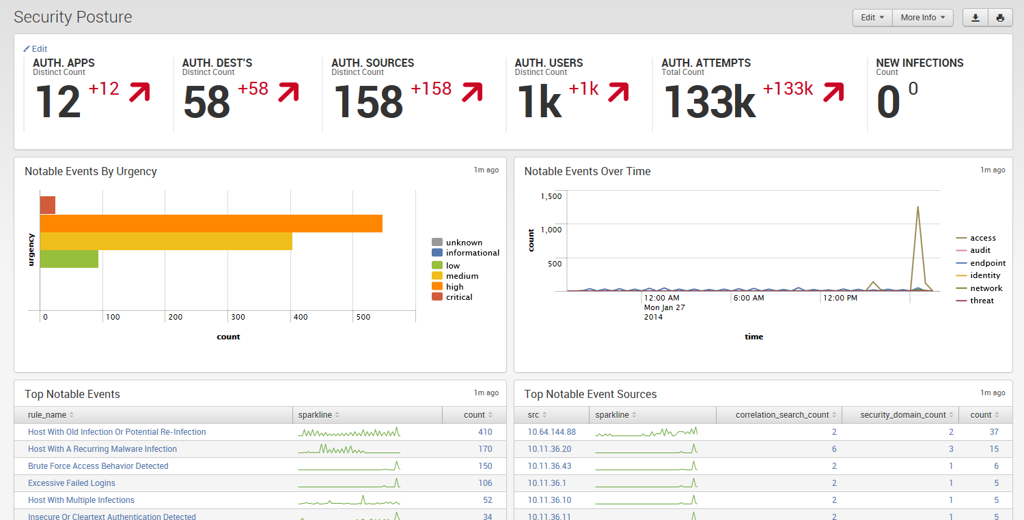
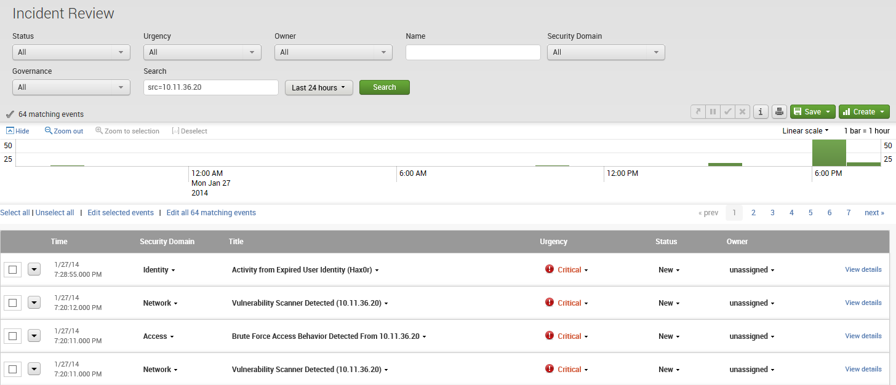
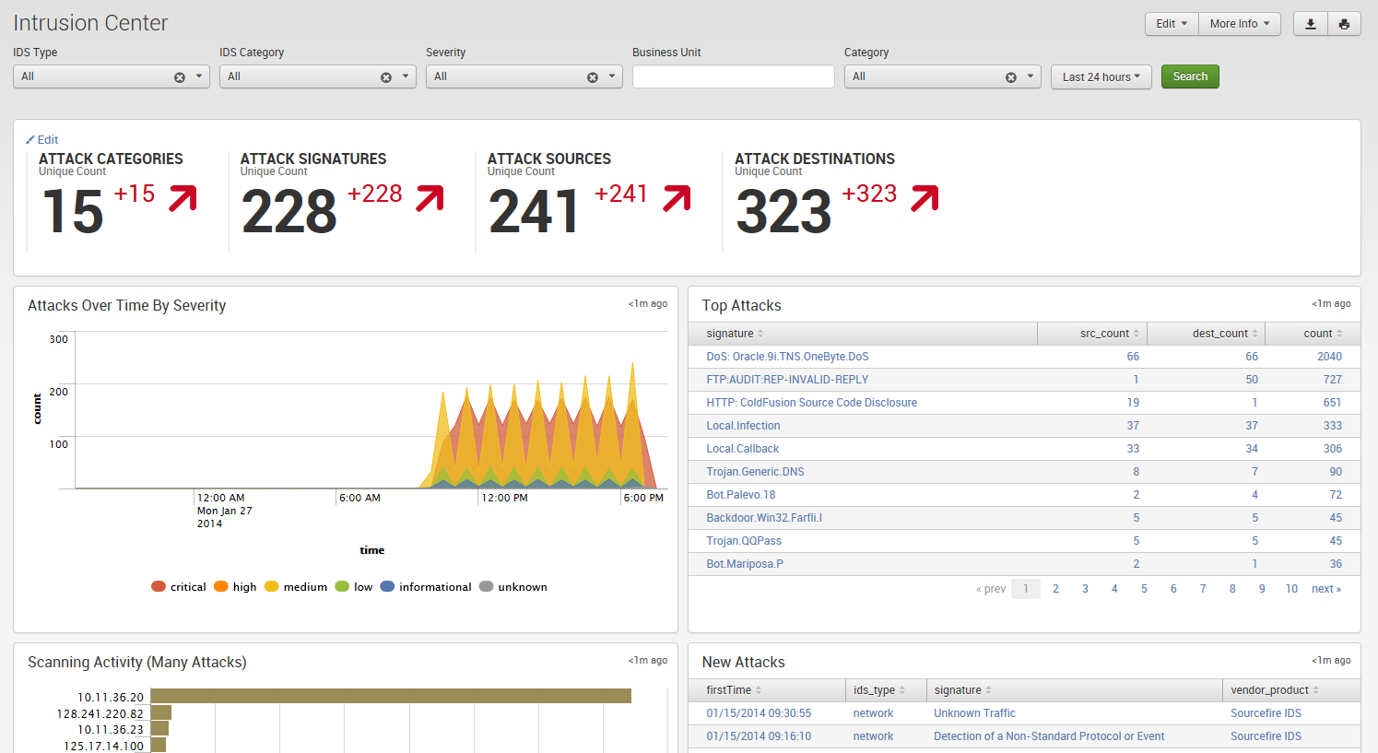
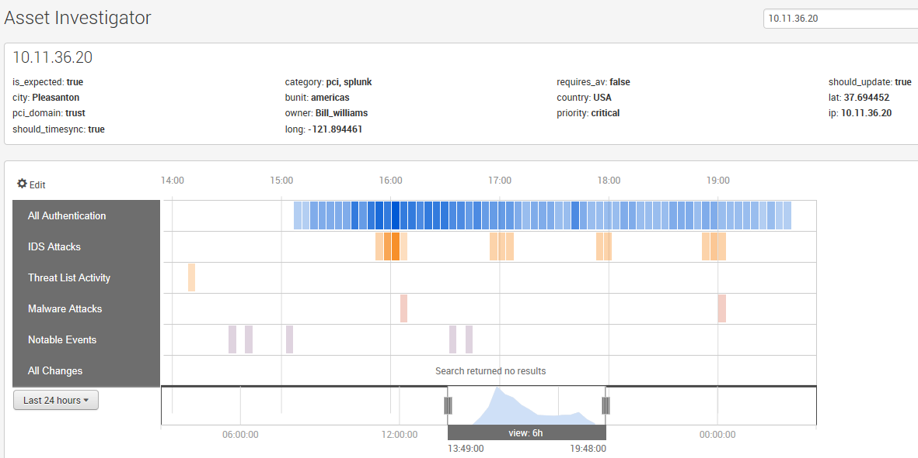
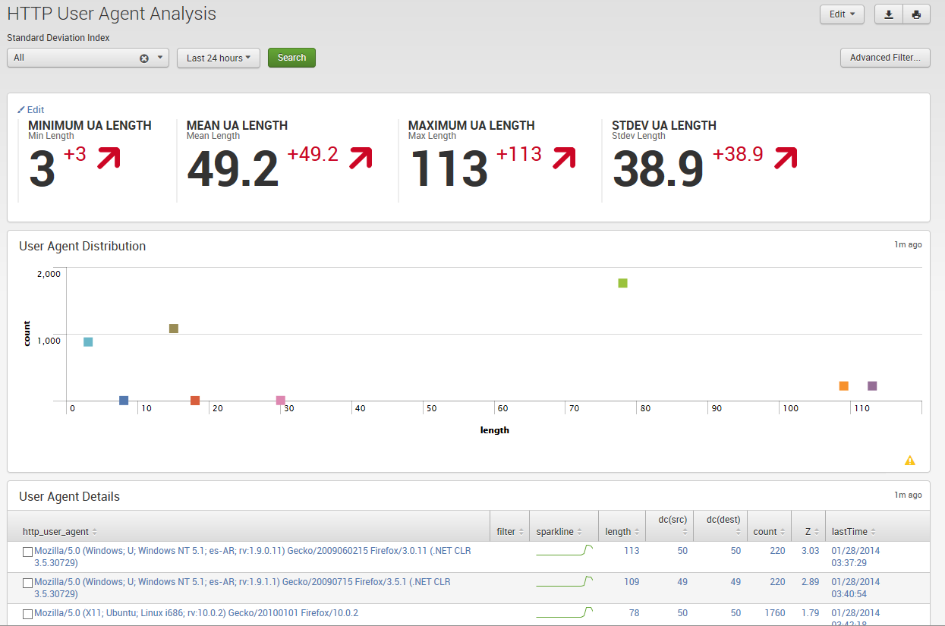
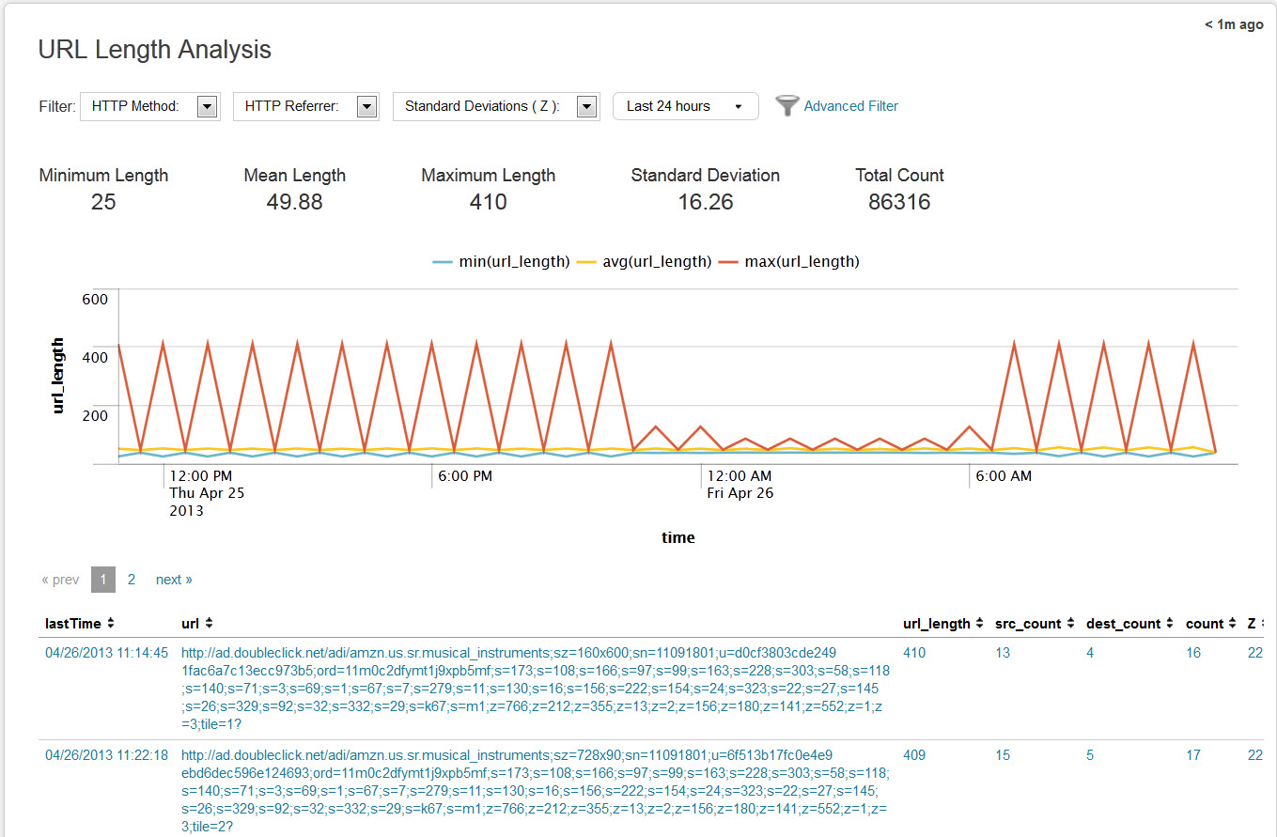
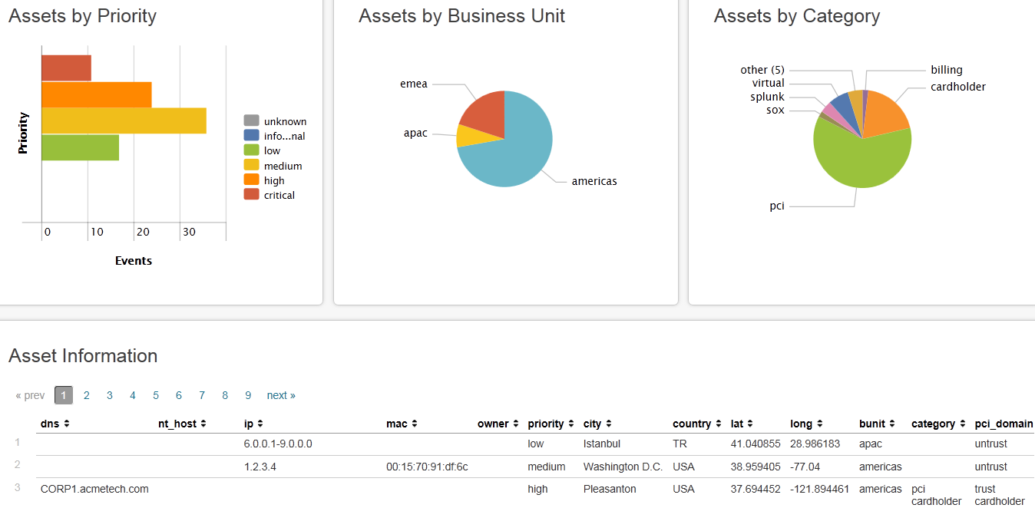
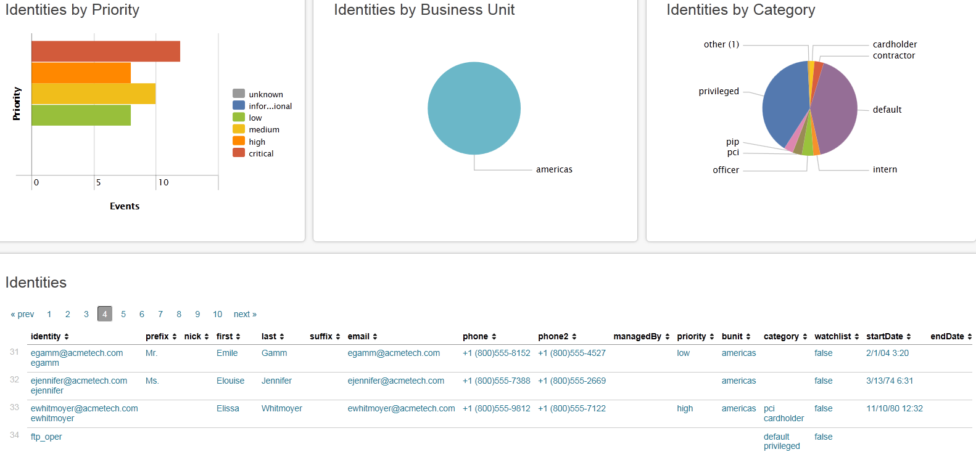
Splunk App for Enterprise Security Pre-built searches, alerts, reports, dashboards, workflow
Dashboards and Reports
Incident Investigations & Management
Statistical Outliers
Asset and Identity Aware
27
Notes:
Over 45 pre-built searches
37 predefined dashboards
160 reports
Supporting common security metrics

Slide 28
Key Takeaways
SOC requires investment in people, process and technology
Splunk Enterprise is a security intelligence platform that can power your SOC
Splunk software makes your SOC personnel and processes more efficient

Slide 29
Next Steps
Splunk Security Advisory Services
Help assess, build, implement, optimize a SOC
Includes people, process, and technology
Can include how to use Splunk within the SOC
Evaluate Splunk Enterprise and the Splunk App for Enterprise Security

Slide 30
Q&A

Slide 31
Thank You!

Slide 32
Appendix

Slide 33
Ticketing Best Practices
Plan Your Queues
Think of Automating Escalations
Attack/Incident Reports Are Your Receipt
Notes:
Have in place strong ticketing/case management system.
Think about queues and interaction with groups outside the SOC. If you need to hand a task to a different group keep in mind you may need to open a ticket on their system as well.
Also determine how to receive tickets and when to open a ticket
Automating escalations is way in the security intelligence platform to automatically grab relevant data for the ticket
Attack/Incident Reports is the ticket with all the detail

Slide 34
MSSP Model
PROS
CONS
Around the Clock
Lacks Agility
Higher Visibility of the Threat Landscape
Actionable Alerting
Dedicated Specialties
Does not know your infrastructure

Slide 35
Whiteboard: Splunk SOC/ES Architecture
Points:
Build from previous architecture
Layer in ES components
Cover ES Search Head – Function – Sizing
Cover TAs – Function – Benefits
Offload Search load to Splunk Search Heads
Auto load-balanced forwarding to Splunk Indexers
Send data from thousands of servers using any combination of Splunk forwarders

Slide 36
Merge the Entity And Adversary Models
Entity
Controls
Monitor
SSCM
Chef
Audit
Tripwire
AD
Graphing
Intel
Exposure
Nmap
Nessus
High
Tripwire
Medium
Scans
Intel
Low
Nessus
Graphing
Chef
AD
High
Medium
DNS
Red Team
Low
IDS/IPS
Outbound
Email
Proxy
Tripwire
Recon
Nmap
OSINT
Delivery
Proxy
Exploitation
Tripwire
IDS/IPS
C2
Intent
Email
DNS
Red Team
Outbound Mon

Slide 37
Example: Connecting the “data-dots”
Delivery, Exploit Installation
Gain Trusted Access
Upgrade (Escalate) Lateral movement
Data Gathering
Exfiltration
Blacklisted IP
Blacklisted IP
Threat Intelligence
Malware download
Continued sessions during abnormal hours, periodicity, patterns, etc.
Network Activity/Security
Malware and endpoint execution data
Sessions across different access points (web, remote control, tunneled)
Program installation
Host Activity/Security
User on machine,
link to program
and process
High confidence event
Med confidence event
Low confidence event
Machine data
Traffic data
Abnormal behavior
Malware install
Auth - User Roles
Notes:
An example of an advanced threat. You need data from the 4 data source categories on the far left in order to connect the dots to see the full activity of the threat

Slide 38
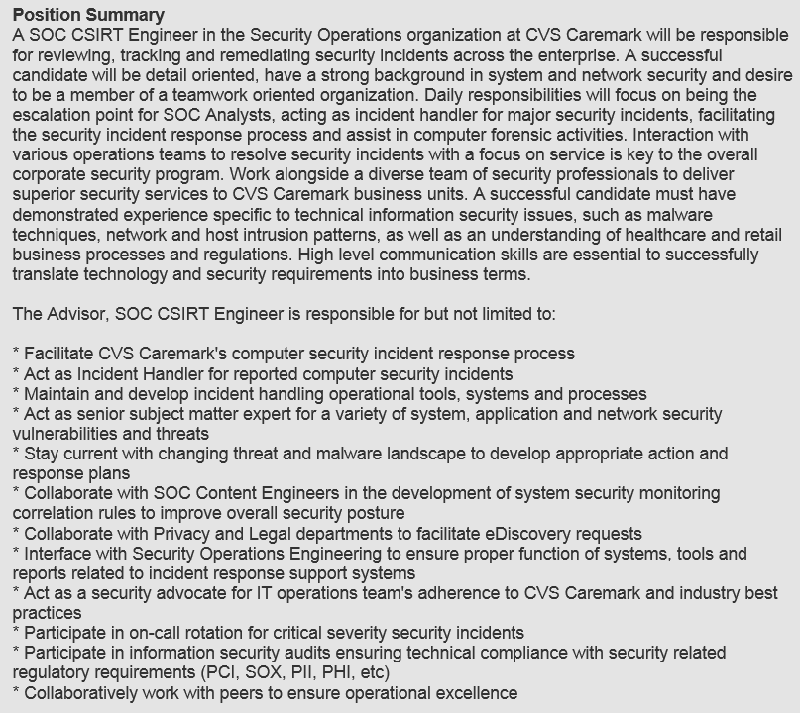
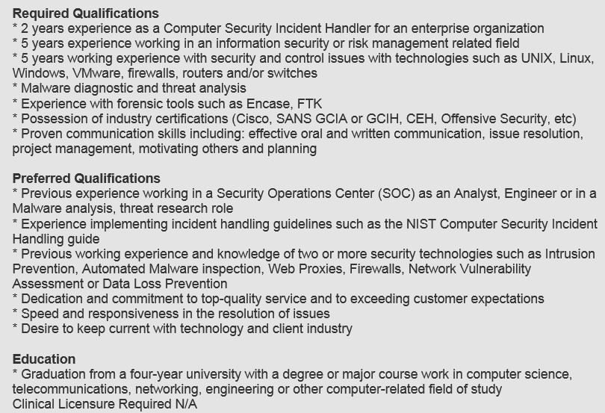
Sample Job Description – Tier 2/3/CSIRT
Notes:
An example of an advanced threat. You need data from the 4 data source categories on the far left in order to connect the dots to see the full activity of the threat

Slide 39
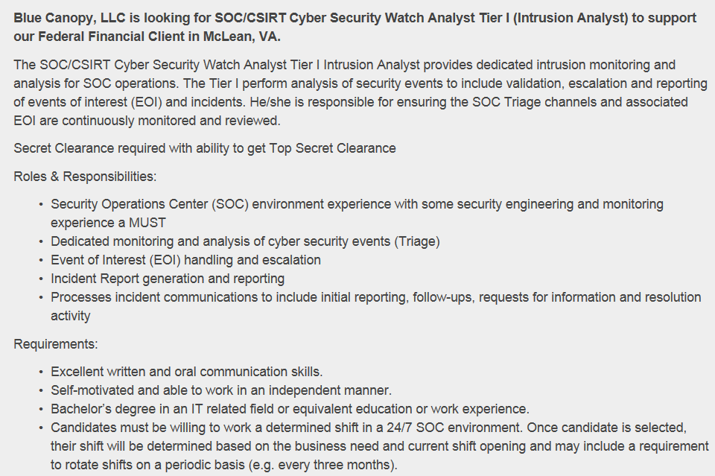
Sample Job Description – Tier 1 SOC
Notes:
An example of an advanced threat. You need data from the 4 data source categories on the far left in order to connect the dots to see the full activity of the threat

